Slide 1
How to develop code for the project:
Put your code into a Jupyter Notebook and keep the output of each cell as part of notebook.
You also need to prepare a power point presentation with below slides:
1-Introduction/Background (Optional)
2- Problem statement or project aim/objectives
2-Methodology
3- Results & Discussion
4- Challenges during execution
5- Lesson learnt
If you are not willing to present your work during the live class, you are more than welcome to record a short 7-15 minutes YouTube video of your work (voice of at least one person is required on video, but face is optional), otherwise you will lose 5% mark. You should submit the link to the recorded video in the beginning cell of your Notebook.
Submission:
Create project folder in Google Drive or GitHub repo to host your code and documents
Upload your PDF version and also PPT version of your presentation to the project folder
Make sure names of all students are in the title slide
Create a text file in your project folder and store the YouTube video link in there
Upload your Python notebook or copy your Colab Notebook to project folder
Make sure you have clear comments on each cell.
Finally, Submit the URL to your project folder as part of your project submission (only one student needs to submit per team).
Make sure your Google Drive Folder is shared with Saeid, Ashish and Sean

Slide 2
Evaluation Criteria
Below are rubrics and their weight
Solution (70%)
Data Description
Data Exploration
Pipeline for your work
Data Preparation (Missing values, outliers)
Data Transformation (normalization, onehotEncoding, log transformation etc)
Trying multiple models
Hyper parameter Tuning
Results (20%)
Interpreting Results
Your actual results and model performance
Coding (5%)
Inline comments
Code Readability
Variable naming consistency
Explaining what you are doing, why you are doing, and what happened after applying the change you just did!
Presentation (5%)
Professional Slides with high quality images/charts without spelling errors
Suitable color/fonts/size considering video projector
Right volume of contents to ensure you can explain contents in the given time
Story telling
Ability to answer question
Manage time

Slide 3
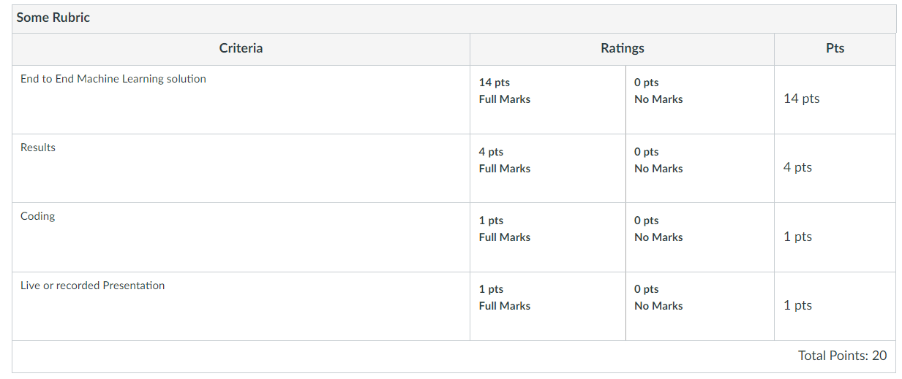

Slide 4


Toronto Police
Major Crime Indicators (MCI)
SCS 3253-061 – Machine Learning
Instructor: Saeid Abolfazli
Team members:
Caio Gasparine Fábio Queiroz
Olivier Sangam Illidan Yuan
April 2023

Slide 5

INTRO / BACKGROUND
Toronto Police
Source of Data: Major Crime Indicators (MCI) Historical
This dataset includes all Major Crime Indicators (MCI) occurrences by reported date and related offences from 2014 to June 30, 2022.
https://data.torontopolice.on.ca/

Slide 6
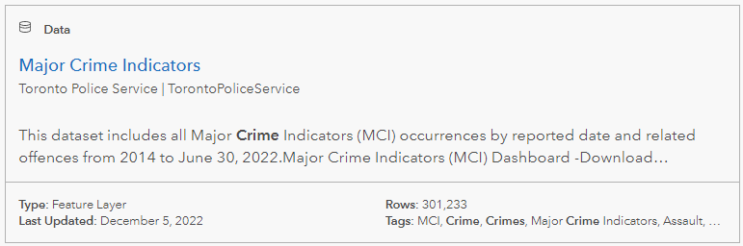
INTRO / BACKGROUND
https://data.torontopolice.on.ca/pages/major-crime-indicators
Toronto Police

Slide 7
INTRO / BACKGROUND
This dataset includes all Major Crime Indicators (MCI) occurrences by reported date and related offences. The MCI categories include Assault, Break and Enter, Auto Theft, Robbery, and Theft Over. This data is provided at the offence and/or victim level, therefore one occurrence number may have several records associated with the various MCIs used to categorize the occurrence. This data does not include occurrences that have been deemed unfounded. The definition of unfounded according to Statistics Canada is: “It has been determined through police investigation that the offence reported did not occur, nor was it attempted” (Statistics Canada, 2020).4
Format: CSV, XML, SHP
https://data.torontopolice.on.ca/datasets/TorontoPS::major-crime-indicators-1/about

Slide 8
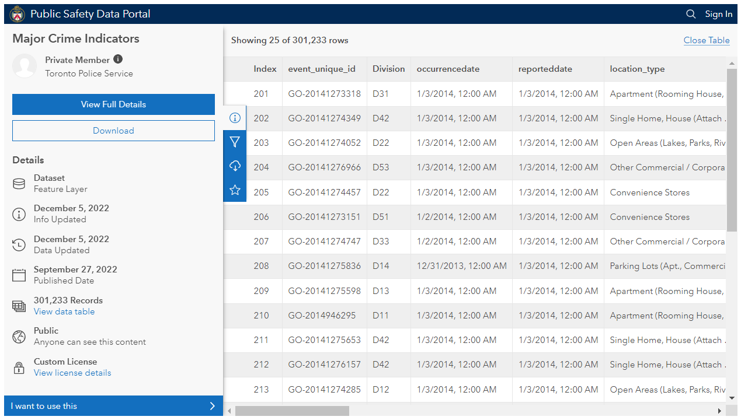
INTRO / BACKGROUND

Slide 9

PROBLEM STATEMENT
The Problem
Crime rates are skyrocketing very fast in Toronto and two main challenges are part of this situation:
(1) identify what would be the probability of a new occurrence considering your geolocation.
(2) determine where would be the optimized location (clusters) for new police patrol based on the current crime rates and location.

Slide 10

PROBLEM STATEMENT
Solution Scope
Develop a solution to address the problem (1) and (2) and give possible alternatives to the problem, based on the historical data analysis.

Slide 11

PROBLEM STATEMENT
Assumptions
Real Time OR Near Real-Time Solution
The enterprise solution architecture must consider automatic data ingestion (and be prepared to scale in an RT/NRT data scenario)
Complete solution (End-2-End), considering the ML model and training + enterprise cloud architecture for future implementation.
Utilization of the current Microsoft Azure infra

Slide 12

METHODOLOGY
Methodology
Big picture / Frame the problem
Get the data / develop the pipeline
Explore and visualize the data to gain insights
Prepare the data for the ML algorithm
Select a model and train it
Fine-tune your model
Present your solution
Launch, monitor, and maintain your system (MLOps)

Slide 13
1. Big picture / Frame the problem
METHODOLOGY
identify what would be the probability of a new occurrence considering your geolocation.
Fields available:
Long + Lat
Location Type
Premises Type
Hood_ID
Neighborhood
(2) determine where would be the optimized location (clusters) for new police patrols based on the current crime rates and location. > Same fields + number of occurrences and critically

Slide 14
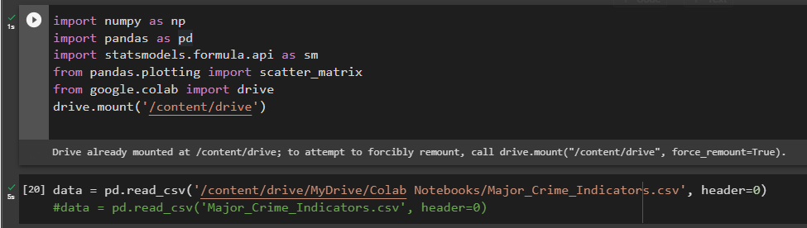
2. Get the data / develop the pipeline
METHODOLOGY

Slide 15
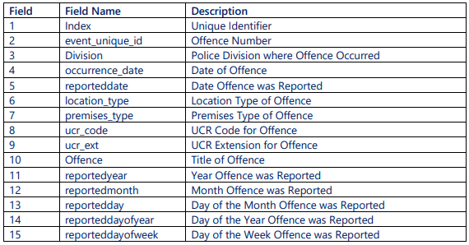
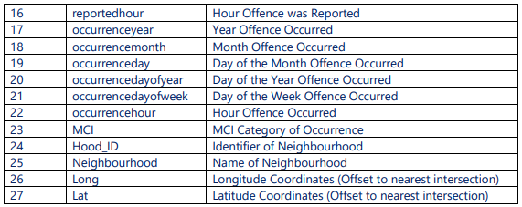
2.1 Data Description
METHODOLOGY
This dataset includes all Major Crime Indicators (MCI) occurrences by reported date and related offences. The MCI categories include Assault, Break and Enter, Auto Theft, Robbery, and Theft Over. This data is provided at the offence and/or victim level, therefore one occurrence number may have several records associated with the various MCIs used to categorize the occurrence. This data does not include occurrences that have been deemed unfounded. The definition of unfounded according to Statistics Canada is: “It has been determined through police investigation that the offence reported did not occur, nor was it attempted” (Statistics Canada, 2020).4
Format: CSV, XML, SHP

Slide 16
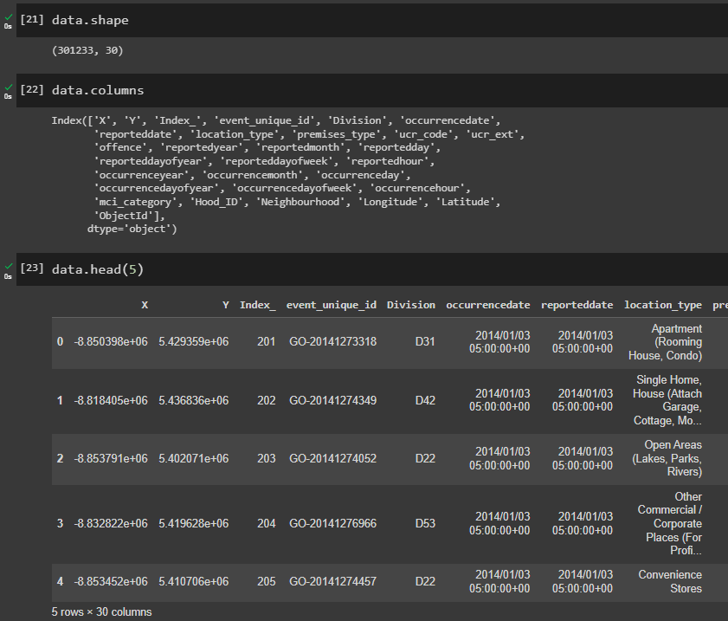
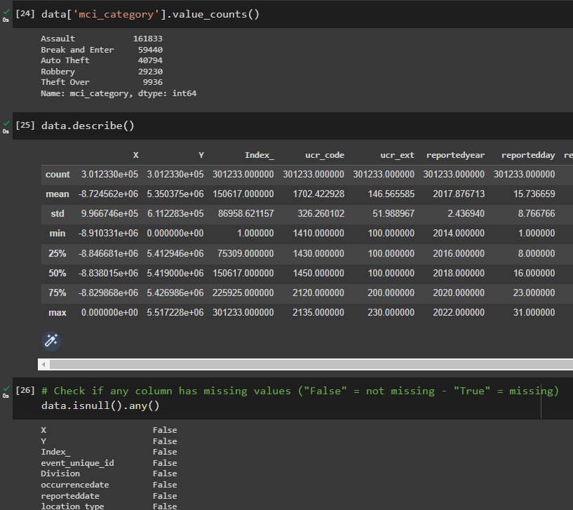
3. Explore and visualize the data to gain insights
METHODOLOGY

Slide 17

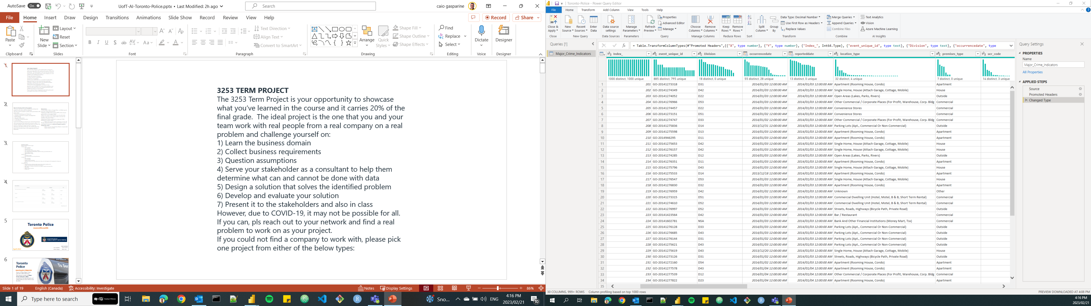
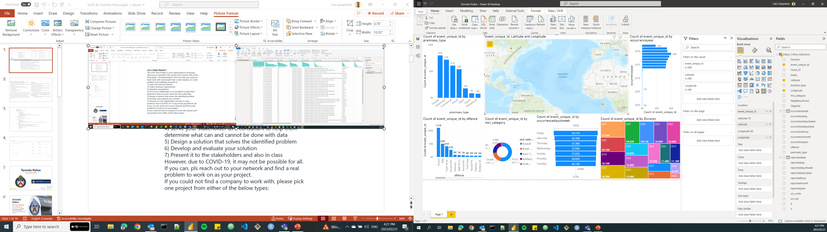
3. Explore and visualize the data to gain insights
METHODOLOGY
Microsoft
PowerBI
Additionally, we used a visualization tool (PowerBI) to explore, visualize and gain insights from the dataset. Easy, fast, and visual.

Slide 18
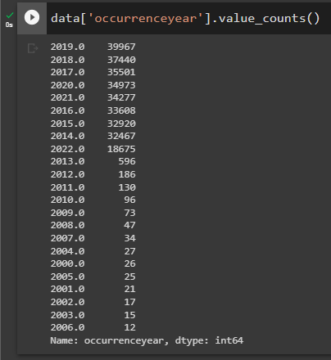
3. Explore and visualize the data to gain insights
METHODOLOGY
Microsoft
PowerBI

Slide 19
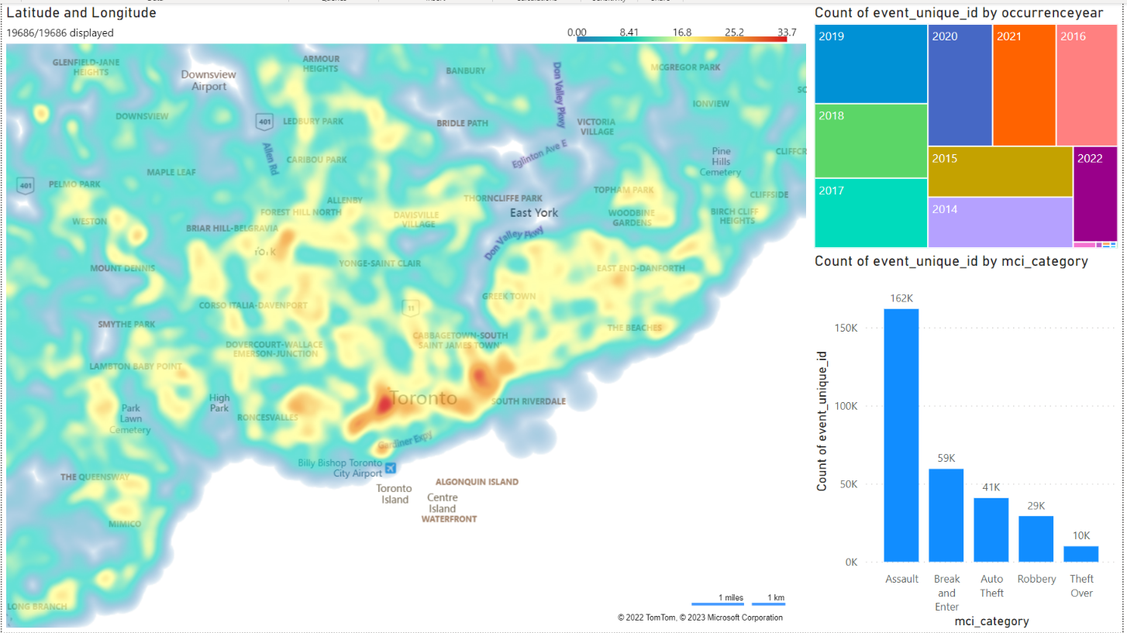
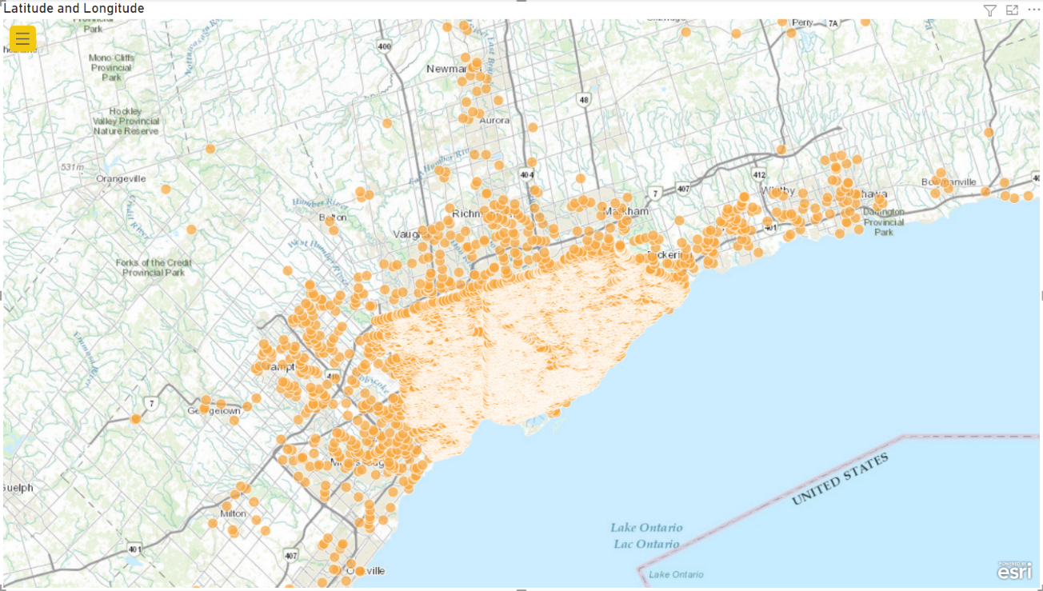
3. Explore and visualize the data to gain insights
METHODOLOGY
Microsoft
PowerBI

Slide 20
4. Prepare the data for the ML algorithm
METHODOLOGY
Big picture / Frame the problem
Get the data / develop the pipeline
Explore and visualize the data to gain insights
Prepare the data for the ML algorithm
Select a model and train it
Fine-tune your model
Present your solution
Launch, monitor, and maintain your system (MLOps challenge)

Slide 21
4.1 Data Transformation
METHODOLOGY
Data Transformation (normalization, onehotEncoding, log transformation etc)

Slide 22
5. Select a model and train it
METHODOLOGY
Big picture / Frame the problem
Get the data / develop the pipeline
Explore and visualize the data to gain insights
Prepare the data for the ML algorithm
Select a model and train it
Fine-tune your model
Present your solution
Launch, monitor, and maintain your system (MLOps challenge)

Slide 23
6. Fine-tune your model
METHODOLOGY
Trying multiple models
Hyper parameter Tuning

Slide 24
7. Present your solution
METHODOLOGY
Big picture / Frame the problem
Get the data / develop the pipeline
Explore and visualize the data to gain insights
Prepare the data for the ML algorithm
Select a model and train it
Fine-tune your model
Present your solution
Launch, monitor, and maintain your system (MLOps challenge)

Slide 25
8. Launch, monitor, and maintain your solution
METHODOLOGY
Big picture / Frame the problem
Get the data / develop the pipeline
Explore and visualize the data to gain insights
Prepare the data for the ML algorithm
Select a model and train it
Fine-tune your model
Present your solution
Launch, monitor, and maintain your system (MLOps challenge)

Slide 26
Results and Model Performance

Slide 27

CHALLENGES
Challenges
Team communication and collaboration (e-mail, WhatsApp, etc.)
Share the code with the whole team and collaborate (GitHub)
Xxx
Xxx
Xxx

Slide 28

LESSONS LEARNED
Lessons Learned
Tools are important, but team collaboration and team interaction are key components in the analysis and scenario validation.
Reproducibility – only if we keep the data cleaning process documented in the code will be possible to reproduce exactly the same result utilizing the original dataset. Avoid manual data cleaning.
Quick reading – The visualization tool (PowerBI) allowed us to do a “quick reading” on the available data, generating quick and easy insights (simple ones).
Correlation – Get rid of highly correlated features because they don’t add any value to your model

Slide 29






Enterprise Solution Architecture
S O U R C E S
I N G E S T
S T O R E
P R O C E S S
V I Z
Storage Account
SQL Database
Azure Machine Learning
Power BI
Data Factory
.CSV file
https://data.torontopolice.on.ca/pages/major-crime-indicators

Slide 30



Team Members
Illidan Yuan
www.linkedin
yilan_Illdian@hotmail.com
Caio Gasparine
IT Project Manager
Data & Analytics
https://www.linkedin.com/in/caiogasparine/
caiogasparine@gmail.com
Olivier Sangam
Electrical Designer
https://www.linkedin.com/in/olivier-mawaba-sangam-46a973108/
mawoliv@gmail.com
Fábio Queiroz
Sr. Data Engineer
https://www.linkedin.com/in/fabiomsq/
fabio.maia82@gmail.com

Slide 31




Tools we used…
Google Collab
GitHub
Microsoft PowerBI
Arc GIS
Microsoft Azure

Slide 32

References
Géron, Aurélien 2022, Hands-On Machine Learning with Scikit-Learn, Keras, and TensorFlow: Concepts, Tools, and Techniques to Build Intelligent Systems, 3rd Edition, O'Reilly Media.
Toronto Police Service, https://data.torontopolice.on.ca/
Toronto Police Service, Public Safety Data Portal, February 2023, MCI documentation, https://data.torontopolice.on.ca/datasets/TorontoPS::major-crime-indicators-1/about
Blob Storage, https://learn.microsoft.com/en-us/azure/storage/blobs/storage-blobs-introduction
Data Factory, https://learn.microsoft.com/en-us/azure/data-factory/
Machine Learning, https://learn.microsoft.com/en-us/azure/machine-learning/
Power BI, https://learn.microsoft.com/en-us/power-bi/fundamentals/videos
Azure icons, https://learn.microsoft.com/en-us/azure/architecture/icons/
* - references consulted between January 24, 2023, and April 6, 2023.

Slide 33

Thank you! ;-)
SCS 3253-061 – Machine Learning
Instructor: Saeid Abolfazli
Team members:
Caio Gasparine Fábio Queiroz
Olivier Sangam Illidan Yuan

